Slide 1

ICT406 IT Professional Environment: Law, Ethics and Privacy Introduction
Lecturer: Dr. Farshid Keivanian
Course Coordinator: Dr. Abbass Ghanbary
a.ghanbary@aapoly.edu.au

Slide 2
Lecture Outline
Unit Objective
What is IT Law
Ethics in IT
Unit Assessment

Slide 3
List of Topics (Direct from Unit Outline)
TOPICS
Explain the role of ethics in the IT profession, and apply ethical codes.
Identify and resolve common ethical issues related to IT.
Assess the implications of ethical problems and critically evaluate solutions to those problems.
Analyse ethical situations using critical thinking techniques and the lens of the law.
present the professional learning ecosystem by incorporating formal and informal sources of learning.
Reflect on a range of dilemmas arising between ethical practice and the law.

Slide 4
Course Objectives (Direct from Unit Outline)
Objectives
Introduction to ethics in the IT industry
Introduction to critical thinking techniques
Professionalism and professional ethics
Ethical theories and analysis
Privacy laws and regulations
Security and crime in cyberspace
Intellectual property and the law
Freedom of speech and Internet content regulation
Emerging technologies and ethical dilemmas
Information Technology and Society

Slide 5
Open-Ended Question
How can organizations effectively integrate ethical practices into their technological advancements to ensure both innovation and responsibility?
Organizations can integrate ethical practices by developing robust ethical guidelines, providing regular training, and fostering a culture of transparency and accountability. In Sydney, for example, a tech company could implement a comprehensive ethics program that includes workshops on data privacy and security, regular audits to ensure compliance, and open forums for discussing ethical concerns. By prioritizing ethical considerations alongside innovation, companies can ensure responsible technological advancements that benefit both the organization and society.

Slide 6
Open-Ended Question
Why is it important for IT professionals to have a strong understanding of IT law?
A strong understanding of IT law helps professionals navigate the legal landscape of their work, ensuring compliance and protecting both the organization and its users. For instance, in Melbourne, IT professionals at a cybersecurity firm must understand data protection laws to ensure their practices align with legal requirements and protect client data.

Slide 7
Contemporary Issues
Information is control.
Law is subjecting human conduct to abide by governance and rules.
The main question is
"How the historic principles can apply or fit into the modern ages of technology?"
Surveillance
Data Protection
Individual Rights and Privacy
Internet and Virtual Communities
Computer Crime
Copyrights
Law enforcement national and international
We discuss the control of information and the role of law in regulating human conduct, posing the main question of how historic principles can be applied to modern technology issues such as surveillance, data protection, individual rights and privacy, internet and virtual communities, computer crime, copyrights, and national and international law enforcement. We invite consideration of how traditional ethical and legal frameworks can adapt to contemporary technological challenges.

Slide 8
Open-Ended Question
How do ethical principles guide IT professionals in their daily work?
Ethical principles provide a framework for making decisions that are not only legally compliant but also morally sound. In Brisbane, an IT consultant might face a decision about whether to report a data breach. Ethical principles would guide them to report the breach promptly, ensuring transparency and protecting users.

Slide 9
Ethics in Information Technology
Ethics relates to the philosophical views and moral belief of a society defining good and bad in that system.
The ethical use of information technology in the society corresponding to the justification of social law in that society regarding how this technology should be used distinguishing between right or wrong (good and bad).
We explain that ethics in information technology involves the philosophical and moral beliefs of a society that define good and bad within that system. We emphasize that the ethical use of IT should align with societal laws, distinguishing right from wrong based on these ethical and legal standards.

Slide 10
Global Issues of IT Ethics
The social impacts of IT is increasing exponentially
Is there international code of ethics? IFIP (International Federation of Information Processing)
Political
Defence
Business
Education
Medical
We highlight the growing social impacts of IT and questions whether there is an international code of ethics to address these issues. We point to the International Federation of Information Processing (IFIP) as a potential source of ethical guidelines across various sectors including political, defense, business, education, and medical fields.

Slide 11
Open-Ended Question
What are some contemporary ethical challenges in IT, and how can they be addressed?
Contemporary challenges include data privacy, AI biases, and cybersecurity threats. Addressing these requires ongoing education, robust security measures, and inclusive data practices. For example, in Canberra, a government agency might implement rigorous security protocols and regular training to safeguard against cyber threats.

Slide 12
IT and Morality
System and User Intention
System and User Behaviour
Machine Decision (Robotics and Morality)
Does computer have mental state?
We explore the ethical considerations of IT by examining the intentions and behaviors of both systems and users, and the moral implications of machine decision-making in robotics. We also raises the philosophical question of whether computers can possess a mental state.

Slide 13
Open-Ended Question
What ethical considerations arise with the use of AI and robotics in various industries?
Ethical considerations include ensuring AI systems do not perpetuate biases and making decisions that prioritize human well-being. In Sydney, a healthcare provider using AI for patient diagnosis must ensure the AI is trained on diverse data sets to avoid biases and improve patient outcomes.

Slide 14
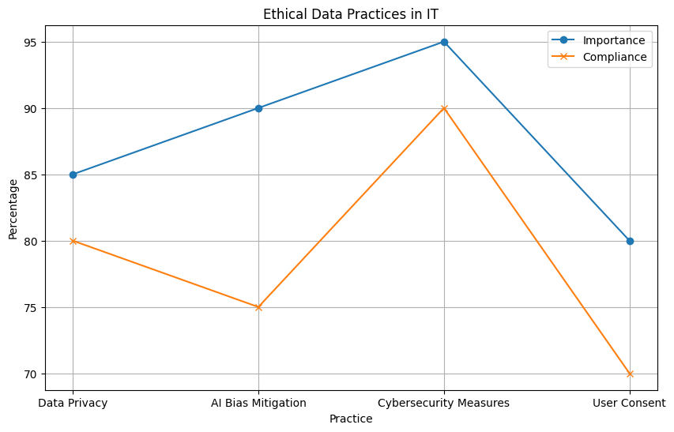
Analysis of Ethical Data Practices in IT
The graph presents the perceived importance and compliance levels of different ethical data practices in IT:
1. Data Privacy:
Importance: 85%
Compliance: 80%
Analysis: Data Privacy is highly valued, with both its importance and compliance scores close to each other. This indicates a relatively balanced perception and implementation of privacy measures.

Slide 15
Analysis of Ethical Data Practices in IT
AI Bias Mitigation:
Importance: 90%
Compliance: 75%
Analysis: While AI Bias Mitigation is seen as very important (90%), there is a notable gap between its importance and compliance (75%). This gap suggests challenges in implementing effective measures to mitigate AI bias.

Slide 16
Analysis of Ethical Data Practices in IT
Cybersecurity Measures:
Importance: 95%
Compliance: 85%
Analysis: Cybersecurity is considered the most important practice (95%) and has a high compliance level (85%). However, the gap indicates that there is still room for improvement in ensuring robust cybersecurity measures.

Slide 17
Analysis of Ethical Data Practices in IT
User Consent:
Importance: 85%
Compliance: 70%
Analysis: User Consent has a significant gap between its perceived importance (85%) and actual compliance (70%). This highlights a critical area where organizations may struggle to obtain and manage user consent effectively.

Slide 18
Analysis of Ethical Data Practices in IT
Highest Importance: Cybersecurity Measures (95%)
Highest Compliance: Cybersecurity Measures (85%)
Largest Gap: AI Bias Mitigation (15% gap)
Lowest Compliance: User Consent (70%)

Slide 19
Analysis of Ethical Data Practices in IT
The analysis indicates that while all practices are deemed important, AI Bias Mitigation and User Consent show significant gaps between importance and compliance. These areas may require more focused efforts to align implementation with the perceived importance. Cybersecurity measures, despite being the highest in both categories, still show room for improvement in compliance to fully meet the high importance placed on them.

Slide 20
Machine Ethics
Right or wrong (good and bad) AI (Artificial Moral or Artificial Ethics)?
Futuristic machines and humanoid robotics
Genomics
Nanotechnologies
Explicit Ethics? How is it possible to define ethics, yet make it explicit
In general, will it be a challenge for science?
We address the ethical challenges posed by advanced technologies such as AI, humanoid robotics, genomics, and nanotechnologies. We question how to define and implement explicit ethics for these technologies and considers whether these ethical challenges will pose significant difficulties for the scientific community.

Slide 21
Artificial Ethical Intelligence
MAP – Mapping Table Processing
Artificial Agent Exhibit learning
Artificial Agent Exhibit Intentions
Further Research required
We discuss the concept of Artificial Ethical Intelligence, highlighting the need for mapping table processing (MAP), the ability of artificial agents to learn and exhibit intentions, and the necessity for further research in this area to develop ethical AI systems.

Slide 22
Moral Responsibility Five Rules
Rule 1:
The people who design, develop, or deploy a computing artifact are morally responsible for that artifact, and for the foreseeable effects of that artifact. This responsibility is shared with other people who design, develop, deploy or knowingly use the artifact as part of a sociotechnical system.
Milller, K. W., (2011), "Moral Responsibility for Computing Artifact"., https://ieeexplore.ieee.org/stamp/stamp.jsp?arnumber=5779006. Downloaded: 20/02/2024
We highlight that individuals involved in the design, development, or deployment of a computing artifact hold moral responsibility for its outcomes and effects. This responsibility extends to others who knowingly use or interact with the artifact within a sociotechnical system.

Slide 23
Moral Responsibility Five Rules- Cont
Rule 2:
The shared responsibility of computing artifacts is not a zero-sum game. The responsibility of an individual is not reduced simply because more people become involved in designing, developing, deploying or using the artifact. Instead, a person’s responsibility includes being answerable for the behaviors of the artifact and for the artifact’s effects after deployment, to the degree to which these effects are reasonably foreseeable by that person.
MMilller, K. W., (2011), "Moral Responsibility for Computing Artifact"., https://ieeexplore.ieee.org/stamp/stamp.jsp?arnumber=5779006. Downloaded: 20/02/2024
We emphasize that the responsibility for computing artifacts is shared but not diminished with more participants. Each individual remains accountable for the artifact's behavior and its foreseeable effects after deployment.

Slide 24
Moral Responsibility Five Rules- Cont
Rule 3:
People who knowingly use a particular computing artifact are morally responsible for that use.
Milller, K. W., (2011), "Moral Responsibility for Computing Artifact"., https://ieeexplore.ieee.org/stamp/stamp.jsp?arnumber=5779006. Downloaded: 20/02/2024
We assert that individuals who knowingly use a specific computing artifact are morally responsible for how it is used.

Slide 25
Moral Responsibility Five Rules- Cont
Rule 4:
People who knowingly design, develop, deploy, or use a computing artifact can do so responsibly only when they make a reasonable effort to take into account the sociotechnical systems in which the artifact is embedded.
Milller, K. W., (2011), "Moral Responsibility for Computing Artifact"., https://ieeexplore.ieee.org/stamp/stamp.jsp?arnumber=5779006. Downloaded: 20/02/2024
We highlight that individuals who design, develop, deploy, or use a computing artifact responsibly must consider the broader sociotechnical systems in which the artifact is embedded, making a reasonable effort to account for these contexts.

Slide 26
Moral Responsibility Five Rules- Cont
Rule 5:
People who design, develop, deploy, promote, or evaluate a computer artifact should not explicitly or implicitly deceive users about the artifact or foreseeable effect, or about sociotechnical systems in which the artifact is embedded.
Milller, K. W., (2011), "Moral Responsibility for Computing Artifact"., https://ieeexplore.ieee.org/stamp/stamp.jsp?arnumber=5779006. Downloaded: 20/02/2024
We emphasize that individuals involved in the design, development, deployment, promotion, or evaluation of a computer artifact should not deceive users about the artifact or its foreseeable effects, nor about the sociotechnical systems in which the artifact is embedded.

Slide 27
Privacy in Public
People become surveillance target
Collect user information without permission
Database may be searched for individual records
We highlight concerns about privacy in public spaces, including the potential for individuals to become surveillance targets, the collection of user information without permission, and the possibility of databases being searched for individual records.

Slide 28
Assessment Methods (Direct from Unit Outline)
Assessment tasks | Week | Wight
1. Early intervention – Online Quiz test comprising of a variety of theoretical questions (MCQs and True/False). | Week 3 | 10%
2. Mid-term test comprising of a variety of theory and calculation questions (Short Answer questions). | Week 6 | 30%
3. Individual report on ethical theories and IT contexts. 1,000 Words equivalent. | Week 9 | 20%
4. Report task for a given ethical dilemma case study. 2,000 Words equivalent. | Week 12 | 40%

Slide 29
Assessment Methods (Direct from Unit Outline)
1. Early Intervention (Week 3, 10%)
Task: Online Quiz Test
Description: Comprises a variety of theoretical questions including Multiple Choice Questions (MCQs) and True/False questions.
Purpose: To assess the initial understanding of key concepts early in the course.

Slide 30
Assessment Methods (Direct from Unit Outline)
2. Mid-Term Test (Week 6, 30%)
Task: Theory and Calculation Questions
Description: Includes a variety of theory and calculation questions (Short Answer questions).
Purpose: To evaluate the comprehension and application of theoretical knowledge and problem-solving skills mid-way through the course.

Slide 31
Assessment Methods (Direct from Unit Outline)
3. Individual Report (Week 9, 20%)
Task: Report on Ethical Theories and IT Contexts
Description: A written report of 1,000 words.
Purpose: To develop and demonstrate the ability to critically analyze and articulate ethical theories in the context of IT.

Slide 32
Assessment Methods (Direct from Unit Outline)
4. Final Report (Week 12, 40%)
Task: Report on a Given Ethical Dilemma Case Study
Description: A detailed report of 2,000 words.
Purpose: To synthesize knowledge from the course and apply it to a complex ethical dilemma, demonstrating a deep understanding and ability to propose solutions.
Each task is designed to progressively build and assess the student's understanding and application of ethical principles in IT contexts, culminating in a comprehensive case study analysis.

Slide 33
Summary
Revision of the unit outline
Information Technology law
Ethics and privacy issues
Unit assessments

Slide 34
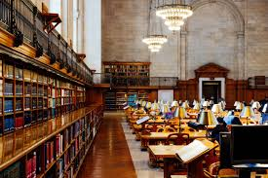
Reading Materials

Slide 35
Books
Gordon, D., Stavrakakis, I., Gibson, J. P., Tierney, B., Becevel, A., Curley, A., ... & O’sullivan, D. (2021). Perspectives on computing ethics: a multi-stakeholder analysis. Journal of Information, Communication and Ethics in Society. Course Accreditation (Existing Provider) (v 2.1) Page 6 of 6
Gunkel, D. J. (2018). The other question: can and should robots have rights?. Ethics and Information Technology, 20(2), 87-99. Kaminski, M. (2020). A recent renaissance in privacy law. Communications of the ACM, 63(9), 24-27.
Niederman, F., & Baker, E. W. (2021, September). Ethics and AI Issues: Old Container with New Wine?. In Conference on e-Business, e-Services and e-Society (pp. 161-172). Springer, Cham.
Winfield, A. F., Michael, K., Pitt, J., & Evers, V. (2019). Machine ethics: the design and governance of ethical AI and autonomous systems [scanning the issue]. Proceedings of the IEEE, 107(3), 509-517

Slide 36
Videos
https://www.youtube.com/watch?v=u399XmkjeXo
https://www.youtube.com/watch?v=Xki2fRA0bY8
https://www.youtube.com/watch?v=0WxOGR6HKFs
https://www.youtube.com/watch?v=MQc-UjE560A

Slide 37
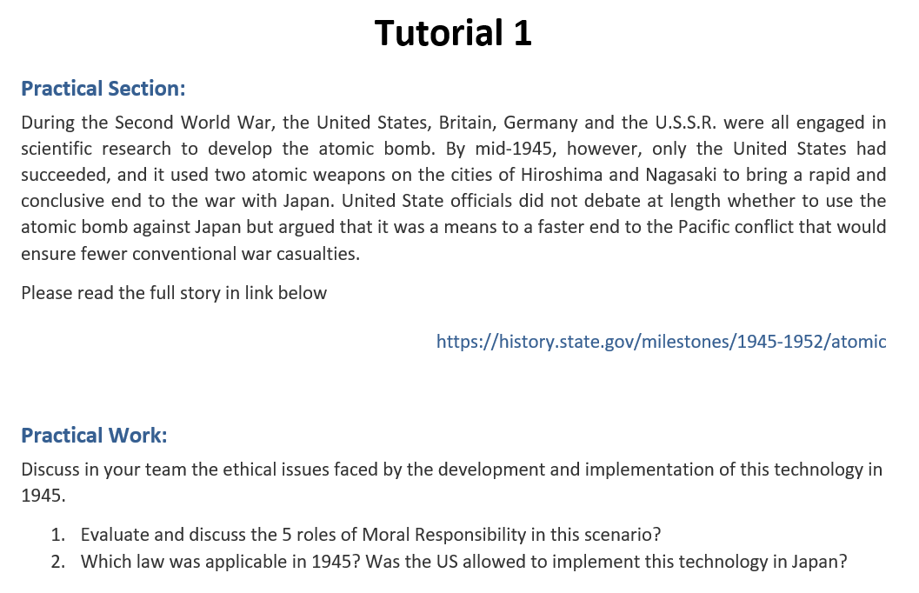
Tutorial Week 1 (Read Article and Answer Questions)

Slide 38
1. Evaluate and discuss the 5 roles of Moral Responsibility in this scenario?
WWII Atomic Bomb Ethical Discussion
Evaluate and discuss the 5 roles of Moral Responsibility in this scenario:
Role 1: Design and Development Responsibility
Discuss the moral implications of scientists and engineers developing the atomic bomb, considering the potential for mass destruction.
Role 2: Decision to Use the Bomb
Analyze the responsibility of U.S. officials in deciding to use the bomb on Hiroshima and Nagasaki.
Role 3: Implementation and Execution
Evaluate the ethical considerations of the military personnel who carried out the bombings.
Role 4: Post-Deployment Consequences
Consider the long-term responsibilities related to the aftermath of the bombings, including radiation effects and rebuilding efforts.
Role 5: Global Diplomatic Impact
Reflect on the moral responsibility of using atomic diplomacy to influence global politics and the ethical ramifications of such actions.

Slide 39
2. Which law was applicable in 1945? Was the US allowed to implement this technology in Japan?
2. Applicable Law in 1945:
Legal Context:
Examine the international laws in place in 1945 and whether the U.S. was legally permitted to use atomic weapons against Japan.
Ethical vs. Legal:
Discuss the distinction between what was legally permissible and what was ethically justifiable in the context of the atomic bombings.

